Slide 1


Math Lessons and Activities
How to use Calculator
Real Numbers
Straight line
Complex Numbers
Solving by CASIO
fx-991EX
Exponents and Radicals
Solving a Quadratic Equation Algebraically
and Graphically
Solving Equations and Inequalities Graphically
Solving by CASIO
fx-82EX
Algebraic Expressions
Sequences and Series
Solving by CASIO
fx-991ARX
The Domain of an Algebraic Expression
Vectors
Table of Signs
Statistics
Math Supplementary lessons and problems

Slide 2

Real Numbers

Slide 3


Real Numbers
Real Numbers
Properties of Real Numbers
Multiplication and Division
Addition and Subtraction
The Real Number Line
Intervals
Absolute value and Distance

Slide 4
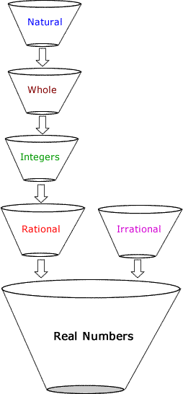
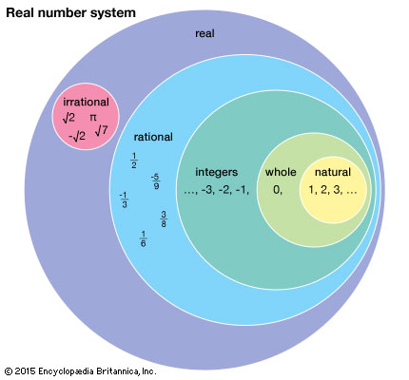
Real Numbers
Type of Numbers | Description
Natural Numbers | Counting Numbers : 1,2,3,4,5,…
Whole Numbers | Counting Numbers starting with 0
Integers | Are Whole numbers and their opposites: -2,-1,0,1,2
Rational | A number that can be made by dividing two integers
Irrational | A real number that can NOT be made by dividing two integers
Real number system
Example
Questions

Slide 5






Questions
Answer by True or False
T
F
-2,0,6,2,1,-100 are all whole numbers
T
F
$\frac{6}{3} , 21,0.001, \sqrt{17}$are all Rational numbers
T
F
$π−π$ is Whole number

Slide 6
Properties of Real Numbers
Can we apply Associative property in subtraction or division? Why?
Properties of Real Numbers | Description
Commutative Property | When we add numbers order doesn’t matter. When we multiply numbers order doesn’t matter.
Associative Property | When we add three numbers, it doesn’t matter which two we add first. When we multiply three numbers, it doesn’t matter which two we multiply first
Distributive Property | When we multiply a number by a sum of two numbers, we get the same result as we would get if we multiply the number by each of the terms and then add the results.
Can we apply Commutative property in subtraction or division? Why?
Question 1
Question 2
Examples

Slide 7
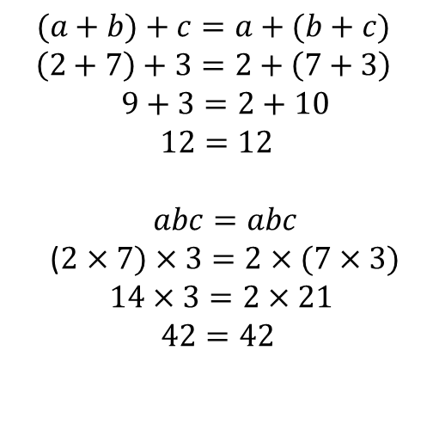

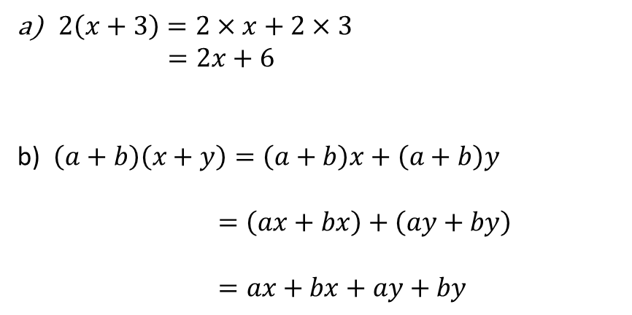
Commutative Property
Distributive Property
$$a+b=b+a$$
$$2+7=7+2$$
$ab=ba$
$$2×7=7×2$$
$2\left(x+3\right)=2×x+2×3$
$=2x+6$
b) $\left(a+b\right)\left(x+y\right)=\left(a+b\right)x+\left(a+b\right)y$
$$=\left(ax+bx\right)+\left(ay+by\right)$$
$=ax+bx+ay+by$
Distributive Property
Simplify
Distributive Property
Distributive Property
Associative Property
Associative Property
$$(a+b)+c=a+(b+c)$$
$$\left(2+7\right)+3=2+\left(7+3\right) \\ 9+3=2+10$$
$12=12$
$abc=abc$
($2×7)×3=2×(7×3)$
$14×3=2×21$
$42=42$
Question

Slide 8




Choose the correct answer:
$3×9=9×3$ is an example of :
$x+2=2+x$ is an example of :
Commutative Property
Commutative Property
Associative Property
Associative Property
Distributive Property
Distributive Property
$5\left(x+3\right)=5x+15$ is an example of :
$x−2=2−x$ is an example of :
Commutative Property
Commutative Property
Associative Property
Associative Property
Distributive Property
Distributive Property

Slide 9
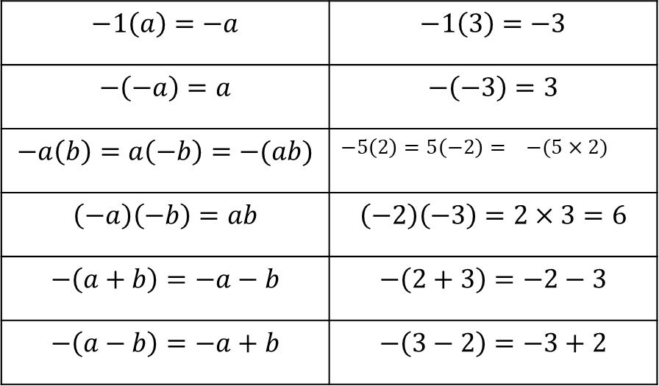




Addition and Subtraction
Examples
Additive identity | $$a+0=0$$
Choose the correct answers
Properties of Negatives
$$−1\left(a\right)=−a$$ | $$−1\left(3\right)=−3$$
$$−\left(−a\right)=a$$ | $$−\left(−3\right)=3$$
$$−a\left(b\right)=a\left(−b\right)=−(ab)$$ | $$−5\left(2\right)=5\left(−2\right)= −(5×2)$$
$$\left(−a\right)\left(−b\right)=ab$$ | $$\left(−2\right)\left(−3\right)=2×3=6$$
$$−\left(a+b\right)=−a−b$$ | $$−\left(2+3\right)=−2−3$$
$$−\left(a−b\right)=−a+b$$ | $$−\left(3−2\right)=−3+2$$
$$−\left(−1+3\right)=−1−3$$
$$−2+3=−(2−3)$$
$$7=−(−7)$$
$$−4\left(−3\right)=−(4×3)$$

Slide 10
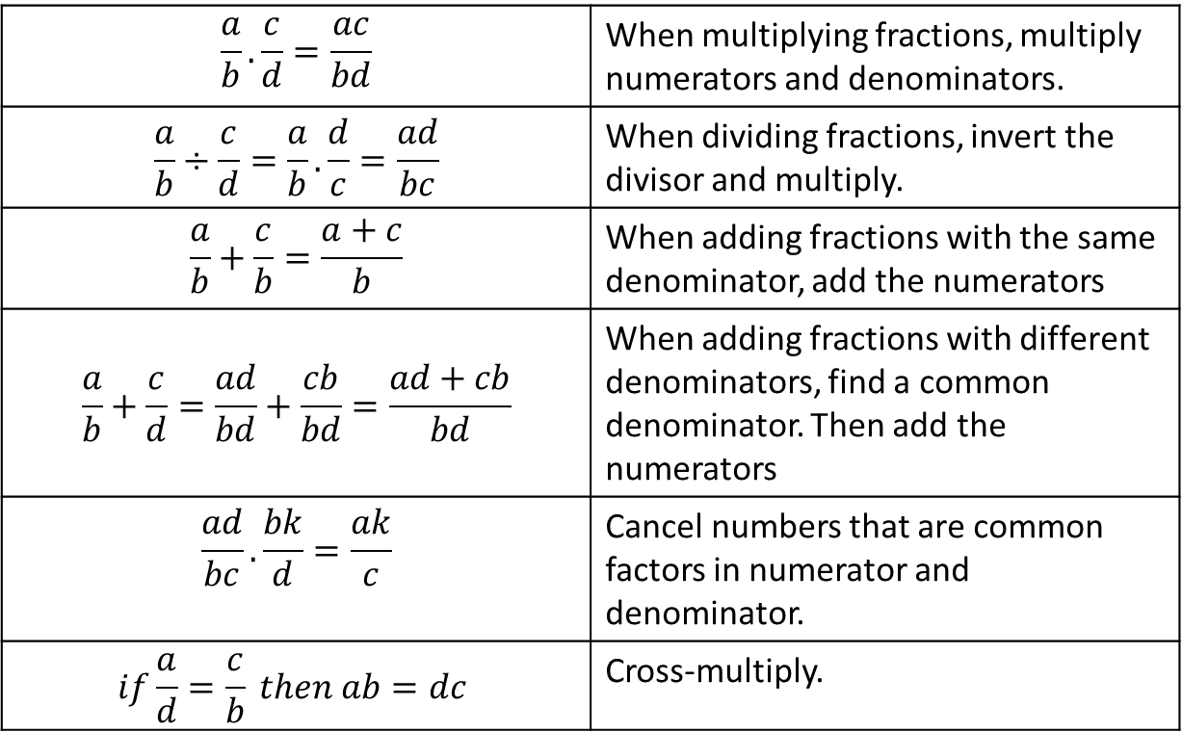

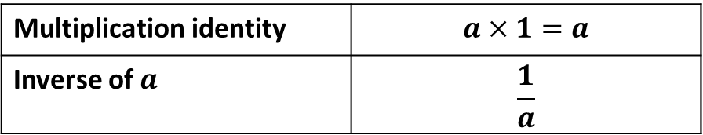

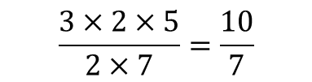

Multiplication and Division
Multiplication identity | $$a×1=a$$
Inverse of $a$ | $$\frac{1}{a}$$
Examples
$$\frac{a}{b}.\frac{c}{d}=\frac{ac}{bd}$$ | When multiplying fractions, multiply numerators and denominators.
$$\frac{a}{b}÷\frac{c}{d}=\frac{a}{b}.\frac{d}{c}=\frac{ad}{bc}$$ | When dividing fractions, invert the divisor and multiply.
$$\frac{a}{b}+\frac{c}{b}=\frac{a+c}{b}$$ | When adding fractions with the same denominator, add the numerators
$$\frac{a}{b}+\frac{c}{d}=\frac{ad}{bd}+\frac{cb}{bd}=\frac{ad+cb}{bd}$$ | When adding fractions with different denominators, find a common denominator. Then add the numerators
$$\frac{ad}{bc}.\frac{bk}{d}=\frac{ak}{c}$$ | Cancel numbers that are common factors in numerator and denominator.
$$if\frac{a}{d}=\frac{c}{b} then ab=dc$$ | Cross-multiply.
Choose the correct answers
$$\frac{3}{2}+\frac{2}{3}=\frac{5}{5}$$
$$\frac{3×2×5}{2×7}=\frac{10}{7}$$
$$\frac{21}{6}÷\frac{7}{2}=\frac{3}{3}$$
$$\frac{9}{7}=\frac{18}{21} then 7×18=21×9$$

Slide 11
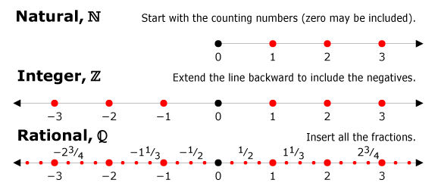
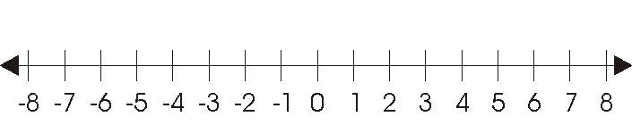
The Real Number Line
Examples
Locate the given points on the number line.
A=3 , B=-4 , C= 1.5, D=9/4

Slide 12


Intervals
Certain sets of real numbers, called intervals, occur frequently in calculus and correspond geometrically to line segments.
Intervals between two numbers a,b include all numbers between the two numbers a, and b
Examples
Open Interval
Closed Interval
If a<b , and the interval is denoted by
(a,b) , then open interval (a,b) include all numbers between a and b
Note: a and b are not included
Set builder notation :
$$\left(a,b\right)=\{x a<x<b\}$$
Ex: (3,6)
If a<b , and the interval is denoted by
[a,b] , then closed interval [a,b] includes all numbers between a and b
and the end points
Note: a and b are included
Set builder notation :
$$\left[a,b\right]=\{x a≤x≤b\}$$
Ex: [3,6]

Slide 13



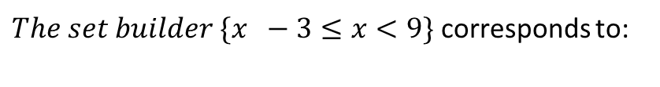
Choose the correct answer:
$$The Graph of interval \left(−2,5\right) is$$
$The set builder \{x −3≤x<9\}$ corresponds to:
[-3,9]
[-3,9)
$$The set builder of interval \left(7,9\right]is$$
$$\{x 7≤x≤9\}$$
$$\{x 7<x≤9\}$$

Slide 14



Absolute value and Distance
It is the distance away from 0
Answer of absolute value is always Positive
$$\left|−3\right|=3$$
$$\left|3\right|=3$$
$$\left|3−9\right|=6$$

Slide 15
Exponents and Radicals

Slide 16
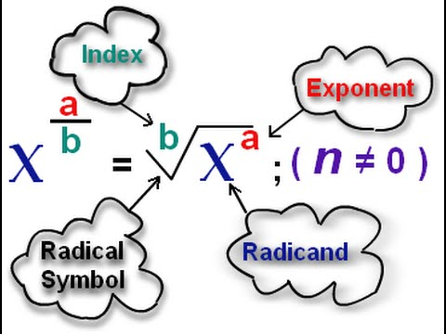
Exponents and Radicals
Rules working with Exponent
Radicals
Rationalizing Denominator
Multiple Choice

Slide 17
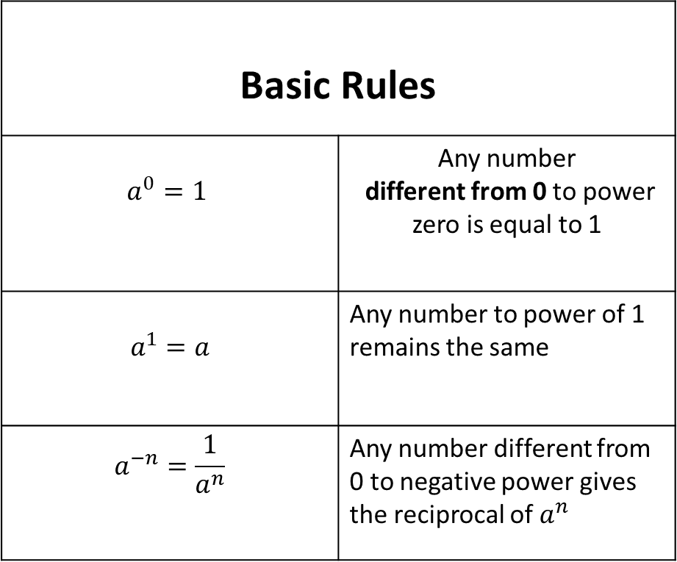
Rules working with Exponent
Basic Rules
$$a^{0}=1$$ | Any number different from 0 to power zero is equal to 1
$$a^{1}=a$$ | Any number to power of 1 remains the same
$$a^{−n}=\frac{1}{a^{n}}$$ | Any number different from 0 to negative power gives the reciprocal of $a^{n}$
More Rules

Slide 18




Rules working with Exponent
Rule 1
$$a^{m}a^{n}=a^{m+n}$$
Use calculator to investigate the rules of exponents
Rule 2
$$a^{m}{÷a}^{n}=a^{m−n}$$
Rule 3
$${\left(ab\right)}^{m}=a^{m}b^{m}$$
Rule 4
$${a^{m}}^{n}=a^{mn}$$

Slide 19
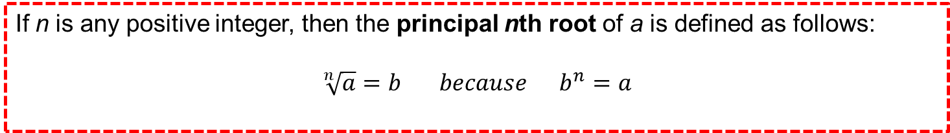



Radicals
If n is any positive integer, then the principal nth root of a is defined as follows:
$$\sqrt[n]{a}=b because b^{n}=a$$
Example 1
Example 2
Example 3
$$\sqrt[3]{27}=3 because 3^{3}=27$$
$$\sqrt[4]{16}=2 because 2^{4}=16$$
$$\sqrt[5]{32}=2 because 2^{5}=32$$
Exploring Radicals

Slide 20
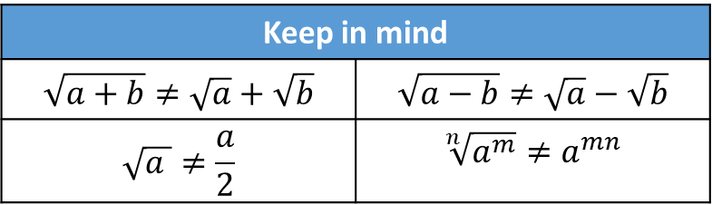


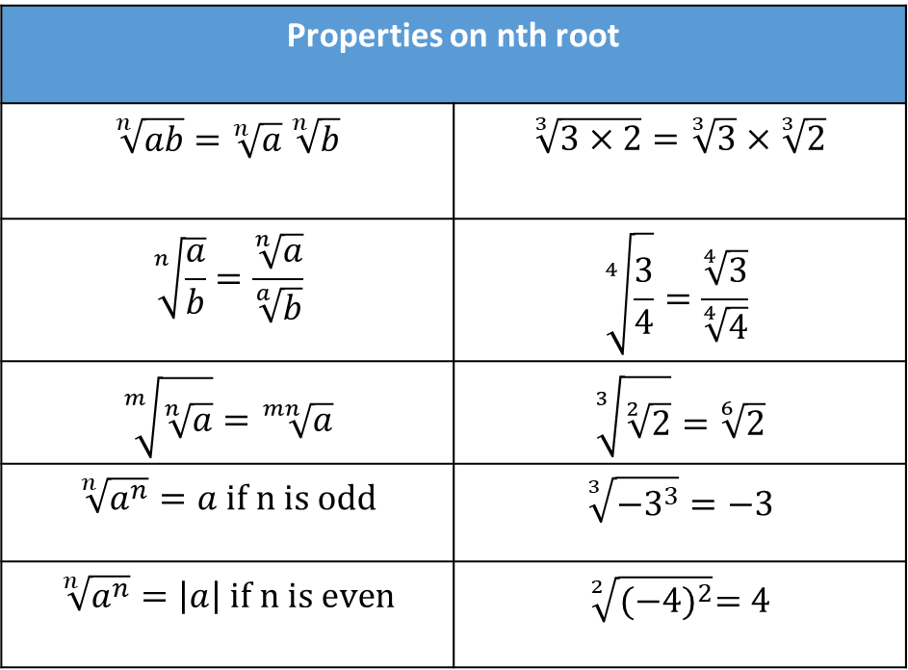
Exploring Radicals
Properties on nth root
$$\sqrt[n]{ab}=\sqrt[n]{a} \sqrt[n]{b}$$ | $$\sqrt[3]{3×2}=\sqrt[3]{3}×\sqrt[3]{2}$$
$$\sqrt[n]{\frac{a}{b}}=\frac{\sqrt[n]{a}}{\sqrt[a]{b}}$$ | $$\sqrt[4]{\frac{3}{4}}=\frac{\sqrt[4]{3}}{\sqrt[4]{4}}$$
$$\sqrt[m]{\sqrt[n]{a}}=\sqrt[mn]{a}$$ | $$\sqrt[3]{\sqrt[2]{2}}=\sqrt[6]{2}$$
$$\sqrt[n]{a^{n}}=a if n is odd$$ | $$\sqrt[3]{−3^{3}}=−3$$
$$\sqrt[n]{a^{n}}=\left|a\right| if n is even$$ | $$\sqrt[2]{{(−4)}^{2}}=4$$
Rational exponents
Any radical of form $\sqrt[n]{a^{m}}$is be written in the form $a^{\frac{m}{n}}$
$$\sqrt[n]{a^{m}}=a^{\frac{m}{n}}$$
Example
$$\sqrt[3]{2^{5}}=2^{\frac{5}{2}}=2^{\left(\frac{4}{2}\right)+(\frac{1}{2})}=2^{2}\sqrt{2}$$
Keep in mind
$$\sqrt{a+b}≠\sqrt{a}+\sqrt{b}$$ | $$\sqrt{a−b}≠\sqrt{a}−\sqrt{b}$$
$$\sqrt{a }≠\frac{a}{2}$$ | $$\sqrt[n]{a^{m}}≠a^{mn}$$
Simplifying Radicals

Slide 21
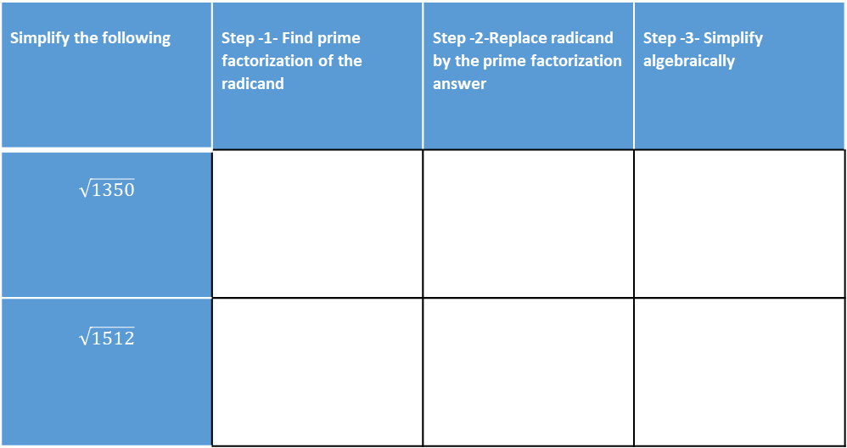
Radicals
Simplify the following | Step -1- Find prime factorization of the radicand | Step -2-Replace radicand by the prime factorization answer | Step -3- Simplify algebraically
$$\sqrt{1350}$$
$$\sqrt{1512}$$

Slide 22
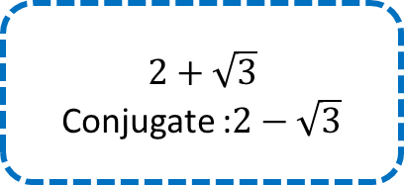
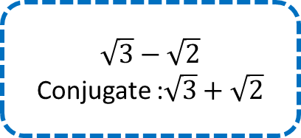
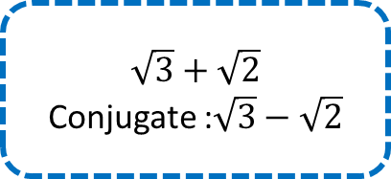

Rationalizing Denominator
Conjugate
Change the sign of the radical in an expression of two term
Example 1
Example 2
Example 3
Example 4
$$2+\sqrt{3}$$
Conjugate :$2−\sqrt{3}$
$$2−\sqrt{3}$$
Conjugate :$2+\sqrt{3}$
$$\sqrt{3}+\sqrt{2}$$
Conjugate :$\sqrt{3}−\sqrt{2}$
$$\sqrt{3}−\sqrt{2}$$
Conjugate :$\sqrt{3}+\sqrt{2}$
Rationalize

Slide 23


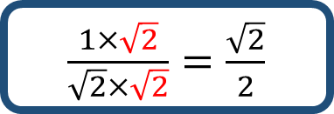
Rationalizing Denominator
Example
$\frac{1}{\sqrt{2}}$
Locate radical in denominator
1
Only 1 term
(radical alone )
Multiply numerator and denominator by the radical it self
$\frac{1×\sqrt{2}}{\sqrt{2}×\sqrt{2}}$
2
2 terms
Multiply numerator and denominator by the conjugate
Simplify
$\frac{1×\sqrt{2}}{\sqrt{2}×\sqrt{2}}=\frac{\sqrt{2}}{2}$
3

Slide 24












Choose the correct answer:
$$\sqrt[3]{2^{8}} is equal to:$$
$$\sqrt{48} in simplified form is :$$
$$4\sqrt[3]{2}$$
$$4\sqrt{3}$$
$$4√2$$
$$\sqrt{3}$$
$$2^{5}$$
$$2\sqrt{3}$$
$$\frac{3+\sqrt{2}}{1−\sqrt{2}} is equal to:$$
$$\frac{5}{ \sqrt{2}}$$
$$\frac{3−\sqrt{2}}{−1 }$$
$$−5−4√2$$

Slide 25
Algebraic Expressions

Slide 26
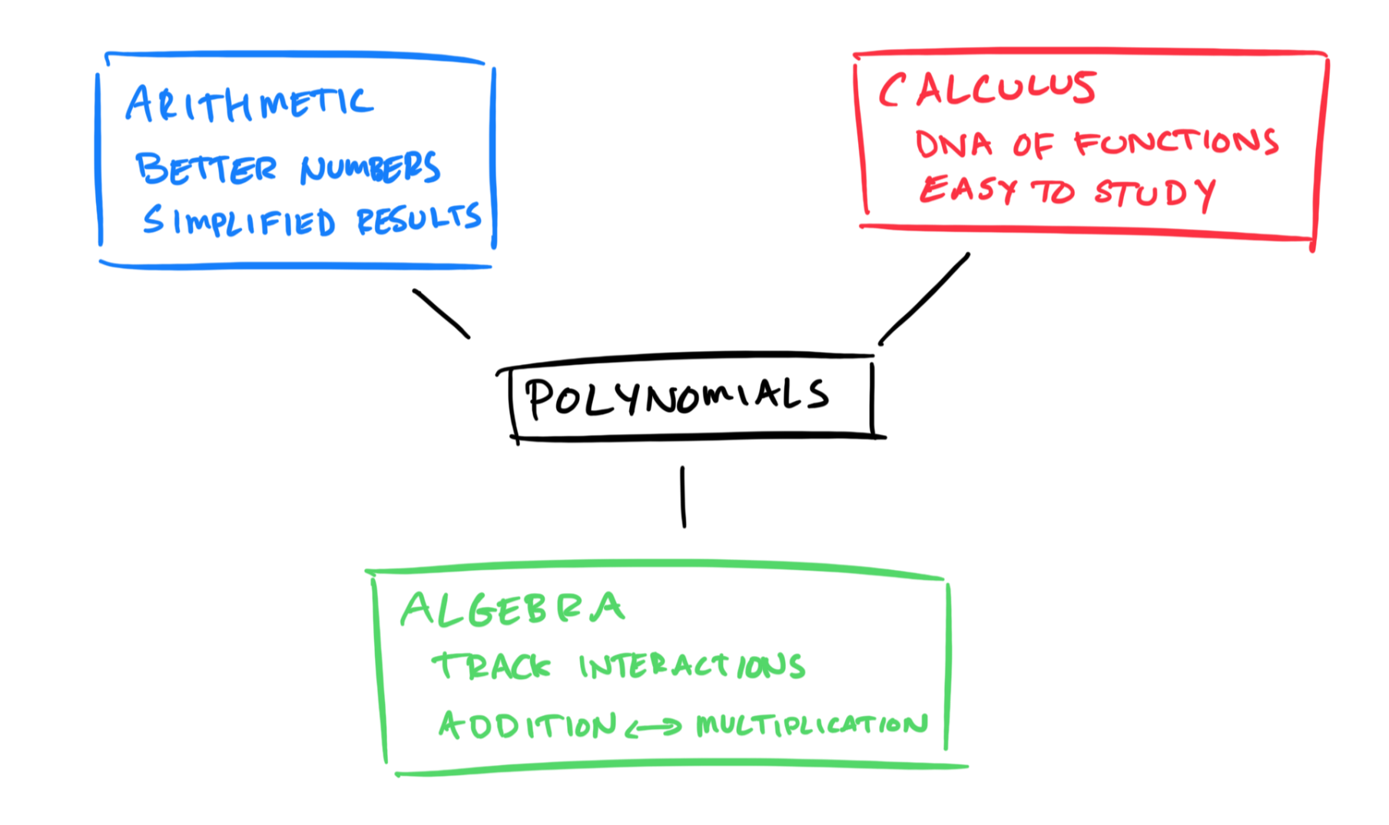
Algebraic Expressions
Adding /Subtracting Polynomials
Multiplying Algebraic Expressions
Special Product Formulas
Special Factoring Formulas
Factoring
Trinomials

Slide 27
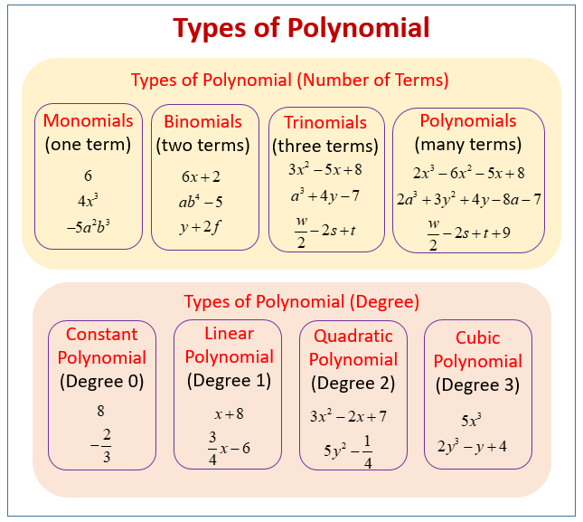



Adding /Subtracting Polynomials
Polynomial
a polynomial is an expression consisting of variables and coefficients, that involves only the operations of addition, subtraction, multiplication, and non-negative integer exponents of variables.
Types of Polynomial
Example
1
$$x+2$$
2
$$x^{3}+2x^{2}+8$$
3
$$x^{9}−8x^{7}+2x^{3}−2x+1$$

Slide 28

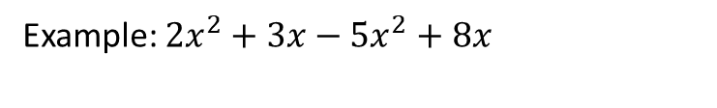

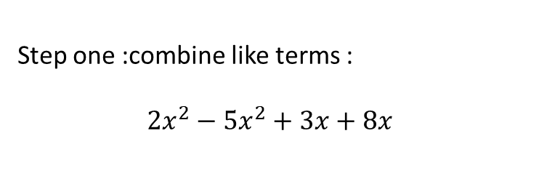



Adding /Subtracting Polynomials
We add and subtract polynomials using the properties of real numbers The idea is to combine like terms (that is, terms with the same variables raised to the same powers)
Like Terms Test
Adding/Subtracting Like Terms
Choose correct answers
1- Combine like terms
2- Add/Subtract coefficients of like terms
$$x^{2}and 3x^{2}are like terms$$
Example: $2x^{2}+3x−5x^{2}+8x$
$${4x}^{3}and 4x^{2}are like terms$$
Step one :combine like terms :
$$2x^{2}−5x^{2}+3x+8x$$
1
$$\frac{x^{3}}{x^{2}}and 4x are unlike like terms$$
2
Step two: add or subtract like terms
$−3x^{2}+11x$

Slide 29

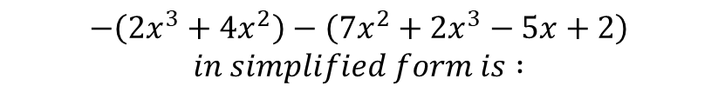
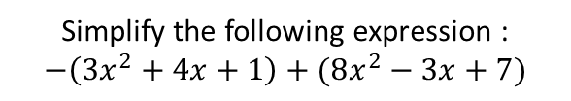








Sample Questions
Question
Simplify the following expression :
$−\left(3x^{2}+4x+1\right)+(8x^{2}−3x+7)$
Choose correct answer
$$−\left(2x^{3}+4x^{2}\right)−\left(7x^{2}+2x^{3}−5x+2\right)$$
$$in simplified form is :$$
1
Since there is parentheses apply distributive property
$−\left(3x^{2}+4x+1\right)+(8x^{2}−3x+7)$
$$−4x^{3}−11x^{2}$$
$$=−3x^{2}−4x−1+8x^{2}−3x+7$$
$$−11x^{2}−4x^{3}+7x$$
2
Combine like terms
$$=−3x^{2}+8x^{2}−4x−3x−1+7$$
$$−8x^{5}$$
3
Add/Subtract like terms
$$−4x^{3}−11x^{2}+5x−2$$
$$=5x^{2}−7x+6$$

Slide 30


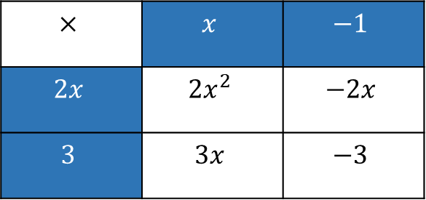





Multiplying Algebraic Expressions
Using Distributive Property
Using Table
$$\left(2x+3\right)\left(x−1\right)$$
$$\left(2x+3\right)\left(x−1\right)$$
$$×$$ | $$x$$ | $$−1$$
$$2x$$ | $$2x^{2}$$ | $$−2x$$
$$3$$ | $$3x$$ | $$−3$$
1
$$\left(2x+3\right)\left(x−1\right)$$
Distributive Property
2
$$2x^{2}−2x+3x−3$$
Combine line terms
$$Answer : 2x^{2}−2x+3x−3$$
$$=2x^{2}+x−3$$
3
$$2x^{2}+x−3$$
Simplify

Slide 31
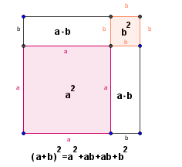
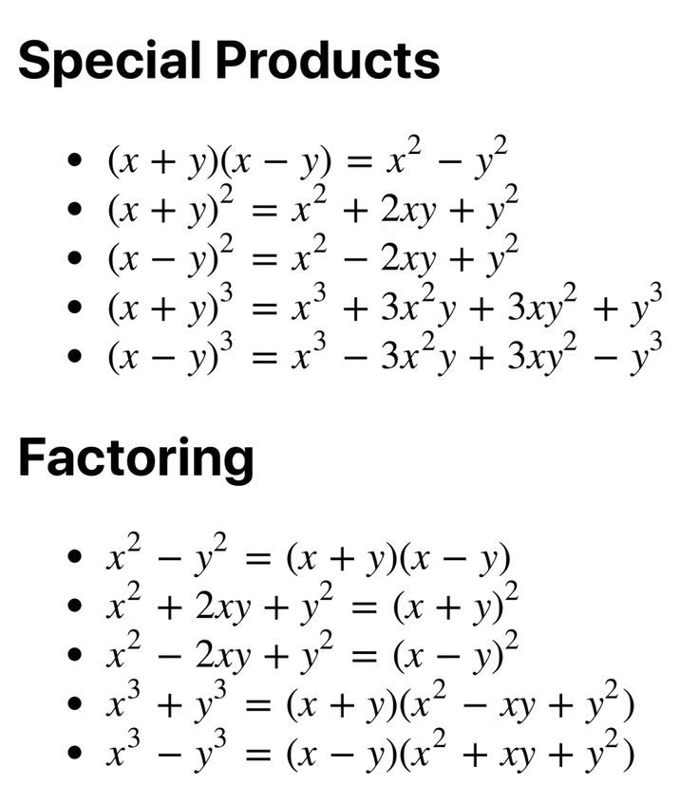
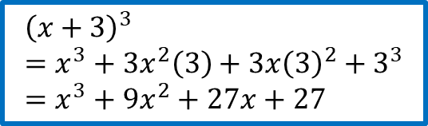
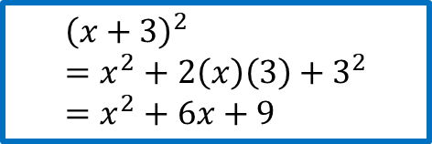
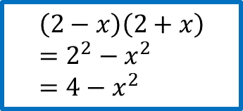
Special Product Formulas
Special Product Formulas
Example 1
Example 2
Example 3
$$\left(2−x\right)\left(2+x\right) \\ =2^{2}−x^{2} \\ =4−x^{2}$$
$${\left(x+3\right)}^{2} \\ =x^{2}+2\left(x\right)\left(3\right)+3^{2} \\ =x^{2}+6x+9$$
$${\left(x+3\right)}^{3} \\ =x^{3}+3x^{2}\left(3\right)+3x{\left(3\right)}^{2}+3^{3} \\ =x^{3}+9x^{2}+27x+27$$
Questions

Slide 32









Choose correct answer
$$\left(x^{2}−3x\right)\left(x^{2}+2x−1\right)=$$
$$\left(x+4\right)\left(x−4\right)\left(x−1\right)=$$
$$x^{4}−x^{3}−7x^{2}+3x$$
$$x^{2}−16$$
$$x^{4}+x^{3}+7x^{2}−3x$$
$$x^{3}−x^{2}+16x−16$$
$$x^{4}−x^{3}−7x^{2}−3x$$
$$x^{3}−x^{2}−16x+16$$

Slide 33
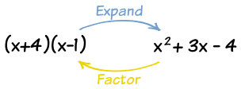
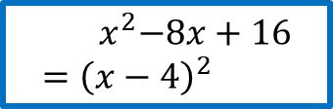
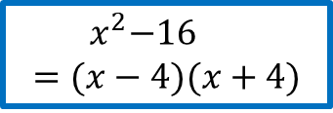
Special Factoring Formulas
Special Factoring Formulas
Example 1
Reset
Example 2
$${ x}^{2}−16 \\ =(x−4)(x+4)$$
$${ x}^{2}−8x+16 \\ ={\left(x−4\right)}^{2}$$

Slide 34

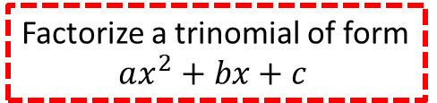

Factoring
Trinomials
Factorize a trinomial of form
$$ax^{2}+bx+c$$
$$if a=1$$
$$if a≠1$$
Example
Example
Questions

Slide 35
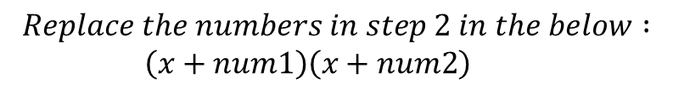
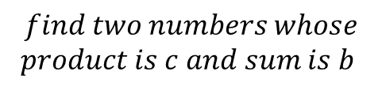




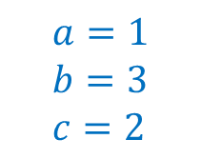

$$if a=1$$
$$x^{2}+3x+2$$
1
Define $a,b, and c$
4
$$Replace the numbers in step 2 in the below :$$
$\left(x+num1\right)\left(x+num2\right)$
$$a=1 \\ b=3 \\ c=2$$
$$Factored form is:\left(x+1\right)\left(x+2\right)$$
2
$$find two numbers whose$$
$$product is c and sum is b$$
Factorize :
$$x^{2}−8x+12$$
Product | Sum
2x1 | 2+1
-2x-1 | -2+(-1)
3
The two numbers are 1 and 2

Slide 36

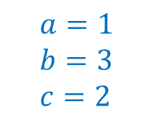







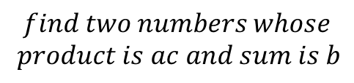

$$if a≠1$$
$${2x}^{2}+13x+15$$
1
$$Define a,b, and c$$
4
Re-write the original expression in the following form :
$$a=1 \\ b=3 \\ c=2$$
$${2x}^{2}+13x+15$$
$${2x}^{2}+10x+3x +15$$
2
$$find two numbers whose$$
$$product is ac and sum is b$$
$$10x+3x=13x \\ 10 and 3 are the numbers found$$
Product | Sum
30x1 | 30+1
-30x-1 | -30-1
15x2 | 15+2
-15x-2 | -15-2
3x10 | 3+10
-3x-10 | -3+-10
5
Group 1st two terms and group last 2 terms
$${2x}^{2}+10x+3x +15$$
Factorize each 2 terms
$$=2x\left(x+5\right)+3(x+5)$$
Take common parentheses
3
$$=(x+5)(2x+3)$$
Factored Form
Two numbers are 3 and 10

Slide 37



$$Factorize each of the following$$

Slide 38

The Domain of an Algebraic/Rational
Expression

Slide 39
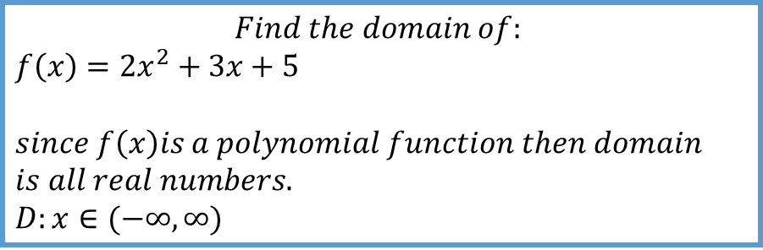
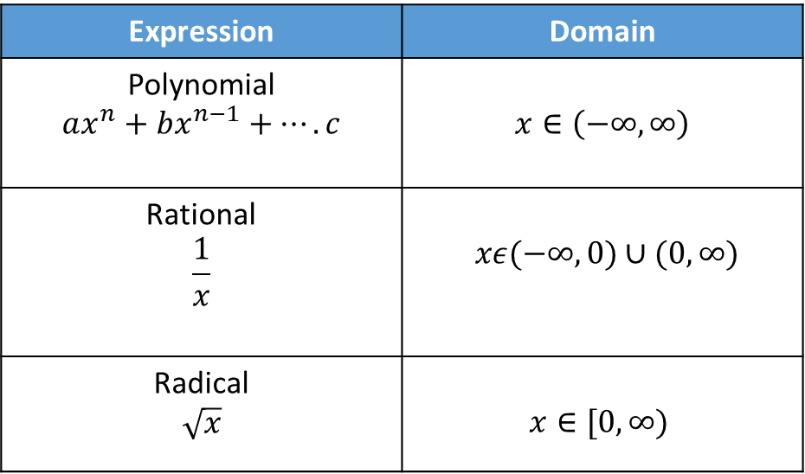


Domain Of Algebraic Expression
An algebraic expression may not be defined for all values of the variable. The
domain of an algebraic expression is the set of real numbers that the variable is permitted to have.
Example 1
Example 2
Example 3
Expression | Domain
Polynomial $$ax^{n}+bx^{n−1}+….c$$ | $$x∈\left(−∞,∞\right)$$
Rational $$\frac{1}{x}$$ | $xε(−∞,0)∪(0,∞)$
Radical $$\sqrt{x}$$ | $$x∈[0,∞)$$
$$Find the domain of:$$
$$f\left(x\right)=2x^{2}+3x+5$$
$$since f\left(x\right)is a polynomial function then domain$$
$$is all real numbers. \\ D:x∈(−∞,∞)$$
$$Find the domain of:$$
$$f\left(x\right)=\sqrt{x^{2}−9 }$$
$$since f\left(x\right)is in radical form , then what ever is$$
$$the radicand should be greater than or euqal to zero$$
$$x^{2}−9≥0 \\ solve for x using CASIO calculator \\ to find roots of x^{2}−9 \\ x=3 ,x=−3$$
$$D:x∈\left(−∞,−3\right]∪[3,∞)$$
$$Find the domain of:$$
$$f\left(x\right)=\frac{2}{x^{2}+5x+6}$$
$$since f\left(x\right)is a rational function then domain depends$$
$$on denominator . Then check denominator≠0 \\ x^{2}+5x+6≠0 \\ solve for x using CASIO calculator \\ x1≠−3 and x2≠−2$$
$$D:x∈(−∞,−2)∪(−3,−2)∪(−2,∞)$$
Questions

Slide 40






Solve and compare your answer :
$$Domain of : \\ \frac{x+1}{\left(x−2\right)\left(x+3\right)}$$
$$Domain of : \\ \frac{2}{\sqrt{x+5}\left(x−2\right)}$$
Answer:
$$x∈(−∞,−3)∪(−3,2)∪(2,∞)$$
Answer:
$$x∈(2,∞)$$
$$Domain of : \\ x+2−\sqrt{x+5}$$
Answer:
$$x∈[−5,∞)$$
Reset

Slide 41
Table of Signs

Slide 42

Table of Signs
Understanding table of signs
Linear Function
Quadratic Function
Radical Function
Rational Function

Slide 43









Table of Signs
Helps in finding the sign of an algebraic expression
Understanding signs
$$Evaluate each given function at given x and study f\left(x\right) sign$$
1
$$if f\left(x\right)=−x^{2}−3x+1 \\ What is the sign of f\left(5\right)?$$
4
$$According to below table answer the following$$
a) sign of f(3),f(-4)
2
$$if f\left(x\right)=x^{2}+5x+\frac{1}{x−6} \\ What is the sign of f\left(3\right)?$$
$$−∞$$
$$−3$$
$$0$$
$$∞$$
$$F(x)$$ | + | - | +
3
$$Given when x∈\left(−2,3\right) , f\left(x\right)>0, and \\ when x∈\left(3,9\right),f\left(x\right)<0. \\ what is the sign of f\left(5\right)?$$

Slide 44













Study the sign of a function
Table of Signs
1
Linear Function
$y=ax+b$
$$locate "\text{a}\text{" }and check its sign \\ Find root \\ then fill the table accordingly$$
$$Example:f\left(x\right)=2x+4$$
$$a=2$$
$$−∞$$
$$Root$$
$$∞$$
$$F(x)$$ | Opposite(a) | Same (a)
$$−∞$$
$$−2$$
$$∞$$
$$F(x)$$ | - | +
$Then$:
$$f\left(x\right)>0 when x∈\left(−2,∞\right) \\ f\left(x\right)<0 when x∈\left(−∞,−2\right) \\ f\left(x\right)=0 when x=−2$$

Slide 45















Study the sign of a function
Table of Signs
2
Quadratic Function
$y=ax^{2}+bx+c$
$$locate "\text{a}\text{" }and check its sign \\ Find root \\ then fill the table accordingly$$
$$Example:f\left(x\right)=x^{2}+5x+4$$
$$a=1$$
$$−∞$$
$$Root1$$
$$Root2$$
$$∞$$
$$F(x)$$ | Same (a) | Opposite (a) | Same (a)
$$−∞$$
$$−4$$
$$−1$$
$$∞$$
$$F(x)$$ | + | - | +
$Then$:
$$f\left(x\right)>0 when x∈\left(−∞,−4\right)∪(−1,∞) \\ f\left(x\right)<0 when x∈\left(−4,−1\right) \\ f\left(x\right)=0 when x=−1 and x=−4$$

Slide 46






Study the sign of a function
Table of Signs
$$f\left(x\right)=3\sqrt{x−2}−3$$
1
$$a=3 \\ h=2 \\ k=−3$$
3
Radical Function
$$y=a\sqrt{x−h}+k$$
a | k | Study of sign
Positive | Positive | $$f\left(x\right)>0 when x∈[h,∞)$$
Positive | Negative | $$f\left(x\right)<0, when x∈\left[h,root\right) \\ f\left(x\right)=0, when x=root \\ f\left(x\right)>0, when x∈(root,∞)$$
Negative | Positive | $$f\left(x\right)>0, when x∈\left[h,root\right) \\ f\left(x\right)=0, when x=root \\ f\left(x\right)<0, when x ∈(root,∞)$$
Negative | Negative | $$f\left(x\right)<0, when x∈[h,∞)$$
Positive | 0 | $$f\left(x\right)=0, when x=h \\ f\left(x\right)>0, when x∈(h,∞)$$
Negative | 0 | $$f\left(x\right)=0, when x=h \\ f\left(x\right)<0, when x∈(h,∞)$$
$$f\left(x\right)<0, when x∈\left[2,3\right) \\ f\left(x\right)=0, when x=3 \\ f\left(x\right)>0, when x∈(3,∞)$$
2
Example

Slide 47











Study the sign of a function
Table of Signs
3
Rational Function
$$y=\frac{f\left(x\right)}{g\left(x\right)}$$
$$Find table of signs of f\left(x\right)and g\left(x\right)$$
$$combined in one tabel \\ Example:E\left(x\right)=\frac{x+1}{x−2}$$
$$f\left(x\right) is linear function$$
$g\left(x\right)is linear function$
$$−∞$$
$$−1$$
$$2$$
$$∞$$
$$F(x)$$ | - | + | +
$$g(x)$$ | - | - | +
$$E\left(x\right)$$ | + | - | +
$Then$:
$$E\left(x\right)>0 when x∈\left(−∞,−1\right)∪(2,∞) \\ E\left(x\right)<0 when x∈\left(−1,2\right) \\ E\left(x\right)=0 when x=−1 only$$
$$Note:g\left(x\right)in denominator then g\left(x\right)≠0$$

Slide 48

Solving Equations and Inequalities Graphically

Slide 49

Solving Equations and Inequalities Graphically
Solving Equations Graphically
Solving Inequalities Graphically

Slide 50






Solving Equations Graphically
1
$$Plot f\left(x\right)=2x+3 and g\left(x\right)=x+8$$
1
Plot the graphs
2
Check for intersection
2
Check for intersection
3
Intersected points (5,13)is the solution
3
Intersected points are the solution
Example1
Example2
$$(5,13)$$
Given $f\left(x\right)=2x+3 and g\left(x\right)=x+8$
Solve graphically
$$g(x)$$
Reset
$$f(x)$$

Slide 51






Given $f\left(x\right)=x^{2}+4x+4 and g\left(x\right)=x+2$
Solve graphically
1
$$Plot f\left(x\right)=x^{2}+4x+4 and g\left(x\right)=x+2$$
2
Check for intersection
3
$$f(x)$$
Intersected points (-1,1) and (-2,0) are the solutions
$$(−1,1)$$
$$(−2,0)$$
$$g(x)$$
Reset

Slide 52






Solving Inequalities Graphically
1
$$Plot f\left(x\right)=2x+3 and g\left(x\right)=x+8$$
1
Plot the graphs
2
Check where $f\left(x\right)is above g(x)$
2
Check which graph is above the other in specific domains
3
Shade area where $f\left(x\right)is above g(x)$
3
Shade area depending on question
Example1
Example2
Given $f\left(x\right)=2x+3 and g\left(x\right)=x+8$
$$for what value of x f\left(x\right)>g(x)$$
Reset
$$f\left(x\right)>g\left(x\right), when x∈(5,∞)$$

Slide 53






Given $f\left(x\right)=x^{2}+4x+4 and g\left(x\right)=x+8$
$$for what value of x f\left(x\right)<g(x)$$
1
$$Plot f\left(x\right)=x^{2}+4x+4 and g\left(x\right)=x+2$$
2
Check where $f\left(x\right)is below g(x)$
3
Shade area where $f\left(x\right)is below g(x)$
$$f\left(x\right)<g\left(x\right), when x∈(−4,1)$$
Reset

Slide 54
Solving a Quadratic Equation Algebraically
and Graphically

Slide 55

Solving a Quadratic Equation Algebraically
and Graphically
Solving Quadratic Equations Algebraically
Solving Quadratic Equations Graphically
Test

Slide 56

Solving Quadratic Equations Algebraically
Solving Quadratic equations of the form
$$ax^{2}+bx+c=0$$
Discriminant
Completing the Square

Slide 57





Solving Quadratic Equations using Discriminant
Discriminant tells the number of real solutions in a quadratic equation
Calculate Discriminant
Example
Reset
$$Given Quadratic equation of the form \\ ax^{2}+bx+c=0$$
$$D=b^{2}−4ac$$
$$Find the solution\left(s\right)of the following$$
$2x^{2}+8x−3=0$
Rules
Discriminant | Number of Solutions | Rule to find solutions
$$D<0$$ | No real solution
$$D=0$$ | One double root (1 Real solution) | $$x_{1}=x_{2}=−\frac{b}{2a}$$
$$D>0$$ | Two real solutions | $$x_{1}=\frac{−b−\sqrt{D}}{2a} \\ x_{2}=\frac{−b+\sqrt{D}}{2a}$$
1
$$D=b^{2}−4ac \\ =8^{2}−4\left(2\right)\left(−3\right) \\ =64+24 \\ =88 \\ Since D>0 two real roots$$
2
$$x_{1}=\frac{−8+\sqrt{88}}{2×2}=\frac{−4+\sqrt{44}}{2} \\ x_{2}=\frac{−8−\sqrt{88}}{2×2}=\frac{−4−\sqrt{44}}{2}$$

Slide 58








Solving Quadratic Equations using Completing the Square
$$General formula for completing the square$$
$$ax^{2}+bx+c=0$$
$$x^{2}+5x+6=0$$
1
$Isolate \text{"}\text{c}$”
$$ax^{2}+bx=−c$$
$$x^{2}+5x=−6$$
2
$$Divide a by all equation \\ x^{2}+\frac{b}{a}x=−\frac{c}{a}$$
$$x^{2}+\frac{5}{1}x=−\frac{6}{1}$$
$$Perform as below \\ {\left(x+\frac{b}{2a}\right)}^{2}=−\frac{c}{a}+{\left(\frac{b}{2a}\right)}^{2}$$
3
$${\left(x+\frac{5}{2}\right)}^{2}=−6+{\left(\frac{5}{2}\right)}^{2}$$
$$x_{1}=\sqrt{−\frac{c}{a}+{\left(\frac{b}{2a}\right)}^{2}}−\frac{b}{2a}$$
$$x_{2}=−\sqrt{−\frac{c}{a}+{\left(\frac{b}{2a}\right)}^{2}}−\frac{b}{2a}$$
4
$x_{1}+\frac{5}{2}=\sqrt{−6+\frac{25}{4}} then x_{1}=−2$
$$x_{2}+\frac{5}{2}=−\sqrt{−6+\frac{25}{4}} then x_{2}=−3$$

Slide 59

Solving Quadratic Equations Graphically
Rule4
Rule2
Rule1
Rule3

Slide 60






Answer by True or False
$$x=−2 and x=3 are solutions of \\ x^{2}+6x−4=0$$
T
F
$$x^{2}+5x+6=0 has two real roots$$
T
F
$$The Graph of 3x^{2}−5x+8$$
$$intersects x−axis at two points$$
T
F
$$if the graph of ax^{2}+bx+c is above x−axis$$
$$and do not intersect x−axis$$
$$then there are no solutions$$
T
F
Reset

Slide 61
Straight line

Slide 62

Straight line
Lines Introduction
Slope of a line
Equation of a line
Parallel and Perpendicular lines

Slide 63

Lines Introduction
A line is defined as a line of points that extends infinitely in two directions
A line can be extended in both directions.
Infinite points belong to the line

Slide 64






Slope of a line
Slope Property
Slope : is the steepness of the line
Property 1
Property 2
Slope=-2
Slope=-1
Slope=1
Slope=3
Slope Calculation
Slope= infinity
Slope= 0
What can you conclude?
What can you conclude?

Slide 65






Slope Calculation (line passing through two points)
Example
Practice
$$Given points A\left(3,5\right)and B\left(7,1\right). \\ what is the slope of a line$$
$$connecting the two points A and B$$
$$Given points A\left(−3,2\right)and B\left(4,1\right). \\ what is the slope of a line$$
$$connecting the two points A and B$$
1
Formula of slope: $m=\frac{y_{2}−y_{1}}{x_{2}−x_{1}}$
$$y_{2}and y_{1}represents the ordiates of points A and B \\ x_{2}and x_{1}represents the abscissa of points A and B$$
2
Replace values
$$m=\frac{1−5}{7−3}=−\frac{4}{4}=−1$$
Then slope is -1

Slide 66





Equation of a line
Form for the Equation of a line
Slope-Intercept | $$y=mx+b$$ | m is the slope B is the y-intercept
Point Slope | $$y−y_{1}=m\left(x−x_{1}\right)$$ | m is the slope $\left(x_{1},y_{1}\right)$is a point on the line
General Form | $$Ax+By=C$$ | A and B are non zero numbers
Intercept Form | $$\frac{x}{a}+\frac{y}{b}=1$$ | a is x-intercept b is y-intercept
Vertical | $$x=a$$ | Vertical line with “a” as x-intercept
Horizontal | $$y=b$$ | Horizontal line with “b” as y-intercept
Example 1
Choose correct answer
Which equation is of the form Intercept Form ?
$$y−3=4\left(x−2\right)$$
$$y=3x+2$$
$$x+y=1$$
Steps to find equation of a line

Slide 67




Steps to find equations of a line
$$What is the equation of a line passing through points$$
$$A\left(2,5\right)and B\left(0,9\right) in slope point form and slope intercept$$
Practice
1
Find Slope
$$m=\frac{y_{2}−y_{1}}{x_{2}−x_{1}} \\ m=\frac{9−5}{0−2}=\frac{4}{−2}=−2$$
Write equation of a line that passes through points (2,7) and (3,5) in 3 different forms.
2
Replace in equation form of point slope
$y−y_{1}=m\left(x−x_{1}\right)$
$$y−5=−2\left(x−2\right)$$
3
Expand and isolate y in point slope form to reach slope intercept form
$$y−5=−2\left(x−2\right) \\ y−5=−2x+4 \\ y=−2x+9$$

Slide 68




Parallel and Perpendicular lines
Parallel
Perpendicular
$$Two line are parallel if \\ { m}_{1}=m_{2}$$
$$Two lines are perpendicular if \\ m_{1}×m_{2}=−1$$

Slide 69

Sequences and Series

Slide 70

Sequences and Series
Sequence and Series
Practice
Arithmetic Sequence
Geometric Sequence
Arithmetic Series
Geometric Series

Slide 71


Sequence and Series
Sequence
Series
A "sequence is an ordered list of numbers; the numbers in this ordered list are called the "elements" or the "terms" of the sequence.
A "series" is what you get when you add up all the terms of a sequence; the addition, and also the resulting value, are called the "sum" or the "summation".

Slide 72





Choose correct answer
Practice
$$Is the following :2,4,6,8,…$$
Series
$$Given a_{n}=3n+2, write the 1st 10 terms$$
Sequence
$$Given a_{n}=\frac{{\left(n+2\right)}^{2}}{n}−1 , write the 1st 5 terms$$
$$What is the value of the 7th term$$
3,7,11,15,……
4
$$Given$$
$$a_{n}=\frac{{\left(n+2\right)}^{2}}{n−1}−1 , what is the sum of 1st 3 terms$$
28
27
19

Slide 73


Arithmetic Sequence
An arithmetic sequence goes from one term to the next by always adding (or subtracting) the same value. For instance, 2, 5, 8, 11, 14,... is arithmetic, because each step adds three
Example
Formula
Consider the below sequence
To find the nth term apply the following formula:
$$a_{n}=a_{1}+d\left(n−1\right)$$
+3
+3
+3
+3
+3
+3
2
5
8
11
14
17
Example
What is the common difference ?
Find the 6th term
Find the 17th term is the below sequence :
2,5,8,11,…
Answer
+3
1
Find $a_{1},d then replace$
$$d=3 , a_{1}=2 \\ a_{n}=2+3\left(n−1\right) \\ a_{17}=2+3\left(17−1\right)=50$$
Answer
17

Slide 74







Arithmetic Series
An arithmetic series is the sum of the terms of an arithmetic sequence.
$$Find the sum in each case :$$
$\sum_{1}^{15}{n+1}$
$$solution :2+3+4+5+6+7+8+9+10+11+12+13+14+15+16=135$$
$$2) \sum_{1}^{20}{n+3}$$
Arithmetic Series Formula
Example
$$Find the sum of the 1st 9 terms of the given series \\ 1+3+5+7…..$$
$$\sum_{1}^{n}{a_{n}=\frac{n\left(a_{1}+a_{n}\right)}{2}}$$
$$S_{9}=\frac{9\left(1+a_{9}\right)}{2}$$
Find $a_{9}$
$$a_{9}=1+2\left(9−1\right) \\ a_{9}=19$$
$$S_{9}=\frac{9\left(1+19\right)}{2}=90$$

Slide 75



Geometric Sequence
A geometric sequence goes from one term to the next by always multiplying by the same value. So 1, 2, 4, 8, 16,... is geometric, because each step multiplies by two; and 81, 27, 9, 3, 1,... is geometric, because each step multiplying by $\frac{1}{3}$
Example
Formula
Consider the below sequence
To find the nth term apply the following formula:
$$a_{n}=a_{1}×r^{n−1}$$
x2
x2
x2
x2
x2
2
4
8
16
32
64
Example
What is the ratio ?
Find the 6th term
Find the 17th term is the below sequence :
2,4,8,16,32,64,…..
Answer
2
1
Find $a_{1},d then replace$
$$r=2 , a_{1}=2 \\ a_{n}=2×2^{n−1} \\ a_{17}=2×2^{17−1}=131,072$$
Answer
64

Slide 76











Geometric Series
An Geometric series is the sum of the terms of geometric sequence.
$$Find the sum in each case :$$
$\sum_{1}^{15}{4{\left(0.5\right)}^{n−1}}$
$$solution :4,2,1,0.5,0.25,……$$
$$2) \sum_{1}^{20}{6{\left(0.1\right)}^{n−1}}$$
Example
Example
$$Find the sum of the 1st 9 terms of the given series \\ 2+4+8+16…..$$
$$Find the infinite sum of the given series \\ 2+1+0.5+0.25…..$$
Find r
$$r=\frac{1}{2}$$
Geometric Series Formula
$$S_{9}=\frac{2\left(1−r^{n}\right)}{(r−1)}$$
Find r
$$S_{∞}=\frac{2}{(1−r)}$$
$$r=2$$
$$S_{9}=\frac{9\left(1+2^{9}\right)}{2−1}=5,617$$
$$S_{∞}=\frac{2}{1−0.5}=4$$
1
$$\sum_{1}^{n}{a_{n}=\frac{a_{1}(1−r^{n})}{\left|1−r\right|} Finite Geometric sequence }$$
$$\sum_{0}^{∞}{\begin{aligned}a_{n}=\frac{a_{1}}{1−r } infinite Geometric series \\ \\ such that \left|r\right|<1 ,if \left|r\right|>1 no sum \end{aligned}}$$
2
Practice

Slide 77



1) If the first term of an arithmetic series is 2, the last term is 20, and the common difference is +2 …
Determine the number of terms in the series
b) Determine the sum of all the terms in the series
2) A geometric series has a sum of 1365. Each term increases by a factor of 4. If there are 6 terms, find the
value of the first term.
3) Determine if the summation is arithmetic or geometric. Evaluate each series described.
$$a) \sum_{1}^{5}{2n+1}$$
$$c) \sum_{1}^{5}{3^{n}}$$
$$b) \sum_{1}^{5}{4n}$$

Slide 78

Vectors

Slide 79

Vectors
Vector Introduction
Vector Operations
Dot and Cross product
Polar and Cartesian

Slide 80






Vector Introduction
A vector is an object that has both a magnitude and a direction. Geometrically, we can picture a vector as a directed line segment, whose length is the magnitude of the vector and with an arrow indicating the direction. The direction of the vector is from its tail to its head.
Name a vector
Vector Components
To name a vector start from tail to head :
In coordinate plane each vector has $x and y components$
B
B
B
A
A
A
$$\vec{AB}$$
$$\vec{BA}$$
$$\vec{AB}$$
How to calculate vector components

Slide 81








How to calculate vector components
What are the components of vector $\vec{AB}, given A\left(−3,−2\right)and B\left(3,1\right)$
1
Locate head and tail and represent them for corresponding letter
Direction is from A to B
$$B$$
2
Each vector has x and y component
Calculation if x-component
$$x_{\vec{AB}}=x_{B}−x_{A} \left(x of head −x of tail\right) \\ x_{\vec{AB}}=3−(−3)=6$$
Calculation of y-component
$$y_{\vec{AB}}=y_{B}−y_{A} \left(y of head −y of tail\right) \\ y_{\vec{AB}}=1−\left(−2\right)=3 \\ \vec{AB}\left(6,3\right)$$
$$y−component$$
$$A$$
$$x−component$$

Slide 82



Vector Operations
Add/Subtract
Magnitude
Scalar Product
Add or subtract x-component and y –components respectively
Is the length of the vector calculated by the formula
Multiply number by x-component and y –components respectively
$$\vec{AB}\left(2,1\right) \vec{CD}\left(4,2\right) \\ \vec{W}= \vec{AB}+\vec{CD}$$
$$x_{\vec{w}}=x_{\vec{AB}}+x_{\vec{CD}} \\ x_{\vec{w}}=2+4=6$$
$$y_{\vec{w}}=y_{\vec{AB}}+y_{\vec{CD}} \\ y_{\vec{w}}=1+2=3$$
$$\vec{W}\left(6,3\right)$$
$$\vec{AB}\left(2,1\right) \\ \vec{W}=4\vec{AB}$$
$$x_{\vec{w}}=4×x_{\vec{AB}} \\ x_{\vec{w}}=4×2=8$$
$$y_{\vec{w}}={4×y}_{\vec{AB}} \\ y_{\vec{w}}=4×1=4$$
$$\vec{W}(8,4)$$
$$\vec{AB}\left(2,1\right)$$
$$\left\|\vec{AB}\right\|=\sqrt{x_{\vec{AB}}^{2}+y_{\vec{AB}}^{2}}$$
$$\left\|\vec{AB}\right\|=\sqrt{4+1}=\sqrt{5 }$$

Slide 83




Dot and Cross product
Dot product
Cross product
Calculate Cross product
The dot product of u and v is written as u.v and is defined two ways
The cross product is an operation on two three-dimensional vectors which results in a third vector orthogonal to the first two. The length of the cross-product is equivalent to the area of the parallelogram formed by the two vectors.
$u.v=x_{u}x_{v}+y_{u}y_{v}$
$u.v=\left|u\right|\left|v\right|cos\left(θ\right)$
$where θ is angle between the two vectors$

Slide 84


Cross product calculation

Slide 85



Polar and Cartesian
Example
Convert the following from polar to Cartesian :
$$r^{2}=8rsinθ$$
1
Replace $rsinθ by y and r^{2}by x^{2}+y^{2}$
$$r^{2}=8rsinθ$$
$$x^{2}+y^{2}=8y$$
$x^{2}+y^{2}−8y=0$
$Equation of a circle$

Slide 86
Statistics

Slide 87

Statistics
Types of Statistics
Central Tendency
Variation

Slide 88
Types of Statistics
1
Descriptive statistics of a POPULATION
Relevant notation (Greek):
  μ mean
  N population size
  ∑ sum
2
Inferential statistics of SAMPLES from a population.
  Assumptions are made that the sample reflects the population in an unbiased form. Roman Notation:
  X mean
  n sample size
  ∑ sum

Slide 89


Central Tendency
Mean (Average): The sum of all the data entries divided by the number of entries.
Population Mean: $μ=\frac{\sum{x}}{n}$ Sample Mean:$\overline{x}=\frac{\sum{x}}{n}$
Median: The value that lies in the middle of the data when the data set is ordered. If the data set has an odd number of entries, then the median is the middle data entry. If the data has an even number of entries, then the median is obtained by adding the two numbers in the middle and dividing result by two
Mode: The data entry that occurs with the greatest frequency. A data set may have one mode, more than one mode, or no mode. If no entry is repeated the data set has no mode
Example

Slide 90

Find the mean, median, mode, and range for the following list of values:
13, 18, 13, 14, 13, 16, 14, 21, 13
The mean is the usual average, so I'll add and then divide:
$$\frac{\left(13 + 18 + 13 + 14 + 13 + 16 + 14 + 21 + 13\right)}{9} = 15$$
The median is the middle value, so first I'll have to rewrite the list in numerical order:
13, 13, 13, 13, 14, 14, 16, 18, 21
There are nine numbers in the list, so the middle one will be the (9 + 1) ÷ 2 = 10 ÷ 2 = 5th number:
So the median is 14.
The mode is the number that is repeated more often than any other, so 13 is the mode.
The largest value in the list is 21, and the smallest is 13, so the range is 21 – 13 = 8.
Mean
Median
Mode
Range
Reset

Slide 91



Variation
Range: The difference between the maximum and minimum data entries in the set. Range = (Max. data entry) – (Min. data entry)
The standard deviation measure variability and consistency of the sample or population. In most real-world applications, consistency is a great advantage. In statistical data analysis, less variation is often better.
Example

Slide 92


Slide 93

Complex Numbers

Slide 94

Complex Numebrs
Introduction
Add/Subtract complex numbers
Multiply complex numbers
Conjugate
Divide complex number
Trigonometric form of complex number

Slide 95
Introduction
Complex Numbers are written in
the form a + bi, where a is the real
part and b is the imaginary part.
a + bi
real part
imaginary part

Slide 96







Add/Subtract complex numbers
When adding complex numbers,
add the real parts together and
add the imaginary parts together.
1
$$\left(2+5i\right)+(7+3i)$$
Group terms together
$$=9+8i$$
imaginary part
2
$$\left(2−5i\right)−(5−11i)$$
‘Multiply out’ the bracket
(3 + 7i) + (8 + 11i)
$$=2−5i−5+11i$$
Group terms
$$=−3+6i$$
real part
3
$$6\left(1+3i\right)$$
Multiply out the bracket
11 + 18i
$$=6+18i$$
Example

Slide 97






Multiply complex numbers
Complex numbers can be multiplied using the same techniques as used in algebra.
You can also use the following rule to simplify powers of i:
Multiply out the following bracket
$$(2+3i)(4+5i)$$
Multiply put like you would algebraically (eg) grid method, FOIL, smiley face etc)
$$=8+12i+10i+15i^{2}$$
Group i terms, write i² as -1
$$=8+22i+15(−1)$$
Simplify
$$=−7+22i$$
$$i=\sqrt{−1}$$
$$i^{2}=−1$$
Example

Slide 98






Conjugate
You can write down the complex conjugate of a complex number, and it helps you divide one complex number by another
If a complex number is given by:
a + bi
Then the complex conjugate is:
a – bi
(You just reverse the sign of the imaginary part!)
Together, these are known as a complex conjugate pair
The complex conjugate of z is written as z*
Write down the complex conjugate of:
a)
$$2+3i$$
Reverse the sign of the imaginary term
$$2−3i$$
b)
$$5−2i$$
Reverse the sign of the imaginary term
$$5+2i$$
c)
$$1−i\sqrt{5}$$
Reverse the sign of the imaginary term
$$1+i\sqrt{5}$$
Example

Slide 99








Divide complex number
With divisions you will need to write it as a fraction, then multiply both the numerator and denominator by the complex conjugate of the denominator
(This is effectively the same as rationalising when surds are involved!)
Simplify $(10+5i)÷(1+2i)$
$$\frac{10+5i}{1+2i}$$
$$× \frac{1−2i}{1−2i}$$
Multiply by the complex conjugate of the denominator
$$=\frac{(10+5i)(1−2i)}{(1+2i)(1−2i)}$$
Expand both brackets
$$=\frac{10+5i−20i−10i^{2}}{1+2i−2i−4i^{2}}$$
Group i terms, replace the i² terms with -1 (use brackets to avoid mistakes)
$$=\frac{10−15i−10(−1)}{1−4(−1)}$$
Simplify terms
$$=\frac{20−15i}{5}$$
Example
Divide by 5
$$=4−3i$$

Slide 100








Trigonometric form of complex number
y (Imaginary)
You have seen up to this point that a complex number z will usually be written in the form:
The modulus-argument form is an alternative way of writing a complex number, and it includes the modulus of the number as well as its argument.
The modulus-argument form looks like this:
r is the modulus of the number
θ is the argument of the number
z
Hyp
r
rsinθ
Opp
$$z=x+iy$$
θ
x (Real)
rcosθ
Adj
$$z=r(cosθ+isinθ)$$
By Trigonometry:
O
$$Opp=Hyp×Sinθ$$
$$=rsinθ$$
S
H
A
$$Adj=Hyp×Cosθ$$
$$=rcosθ$$
C
H
$$z=rcosθ+irsinθ$$
Example
$$z=r(cosθ+isinθ)$$
Factorise

Slide 101


y (Imaginary)
You can find the modulus-argument form of the complex number z
Express the numbers following numbers in the modulus argument form:
z₁
√3
θ
x (Real)
1
$$z_{1}=1+i\sqrt{3}$$
Modulus for z₁
Argument for z₁
$$\sqrt{1^{2}+{\sqrt{3}}^{2}}$$
$$Tan^{−1}\left(\frac{\sqrt{3}}{1}\right)$$
$$=2$$
$$=\frac{π}{3}$$
$$z_{1}=r(cosθ+isinθ)$$
$$z_{1}=2\left(cos\frac{π}{3}+isin\frac{π}{3}\right)$$

Slide 102

Rounding
Statistics
Inequalities 2nd ,3rd , 4th Degree
Spreadsheet
Scientific Notation
Unit Conversion
Angle Conversion
Introduction on
fx-991EX
Prime Factorization
Solving Equations of degree one ,Logarithmic and Exponential
Table
Fractions
Complex number
Vectors
Order of operation
Equations Degree two to Degree 4
Derivative
Radicals
System of 2,3,and 4 unknowns
Integral

Slide 103





552 Functions

Slide 104


Slide 105


Slide 106


Slide 107



Slide 108

GCD, and LCM

Slide 109


Slide 110


Slide 111



Slide 112


Slide 113



Slide 114


Slide 115


Slide 116


Slide 117


Slide 118


Slide 119


Slide 120


Slide 121


Slide 122


Slide 123


Slide 124


Slide 125



Slide 126


In order to use table using fx-991EX :

Slide 127


Slide 128


Slide 129


Slide 130


Slide 131


Slide 132

Numerical Expressions
Fractions
Introduction on
fx-82EX
Rounding
Radicals
Statistics
Angle Conversion
Table
Scientific Notation
Prime Factorization

Slide 133

Introduction
274 Functions

Slide 134

Numerical expression

Slide 135

Rounding

Slide 136

Statistics

Slide 137

Table

Slide 138

Scientific Notation

Slide 139

Prime Factorization

Slide 140

Fractions

Slide 141


Slide 142

Radicals

Slide 143


Slide 144

Angle Conversion

Slide 145


Slide 146

التكامل المحدد
الإحصاء
تحويل مترى
التقريب
جدول البيانات
الأعداد المركبة
معادلات من الدرجة الاولى
تنبيه علمي
الجدول
حل معادلات لوغاريتمية
التحليل الى عوامل أولية
المصفوفات
حل معادلات من الدرجة الثانية الى الرابعة
الكسور
المتجهات
حل نظم المعادلات
ترتيب العمليات
المشتقات
متباينات
الجذور

Slide 147


Slide 148


Slide 149


Slide 150


Slide 151


Slide 152


Slide 153


Slide 154


Slide 155


Slide 156


Slide 157


Slide 158


Slide 159


Slide 160


Slide 161


Slide 162


Slide 163


Slide 164


Slide 165


Slide 166


Slide 167


